Slide 1
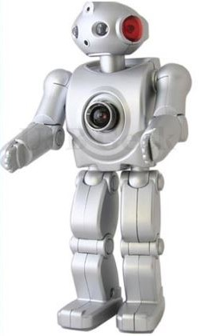
SACRED HEART DEGREE COLLEGE SITAPUR - ARTIFICIAL INTELLIGENCE
Presented to : Presented By:
Miss NEHA RASTOGI SHUBHAM PATKAR
H.O.D BCA

Slide 2
ARTIFICIAL INTELLIGENCE
Artificial Intelligence is a branch of Science which deals
with helping machines finds solutions to complex problems
in a more human-like fashion.
This generally involves borrowing characteristics
from human intelligence, and applying them
as algorithms in a computer friendly way.

Slide 3
Brief History of A I
➢ 1941 : First electronic computer (technology finally available )
➢ 1956 : Term Artificial Intelligence introduced
➢ 1960 : Checkers-playing program that was able to play games with opponents
➢ 1980 : Quality Control Systems
➢ 2000 : First sophisticated walking robot

Slide 4
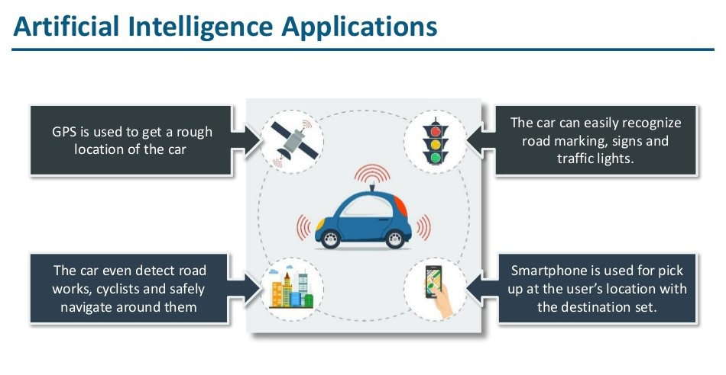

Slide 5
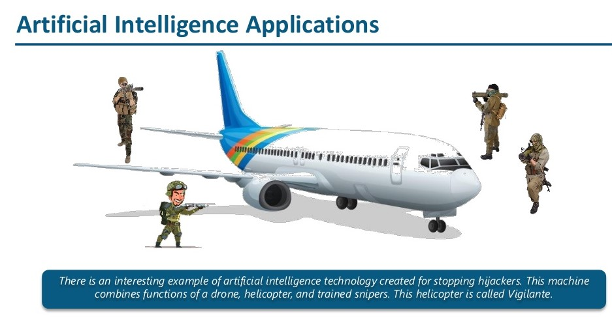

Slide 6
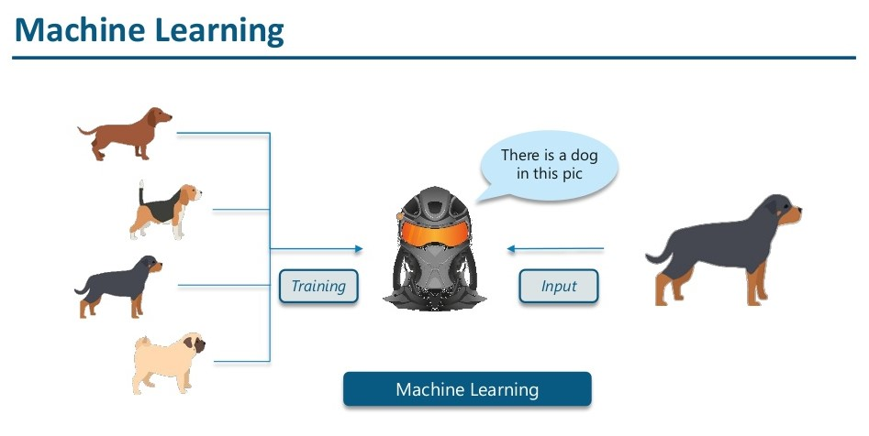
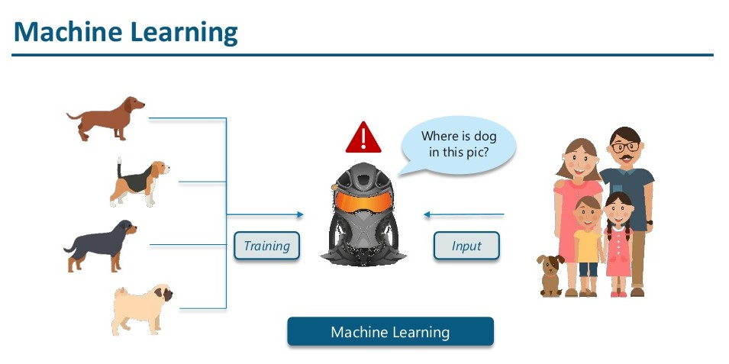
MACHINE LEARNING

Slide 7
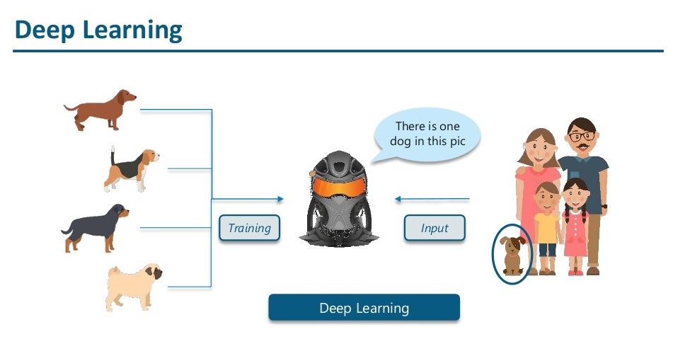
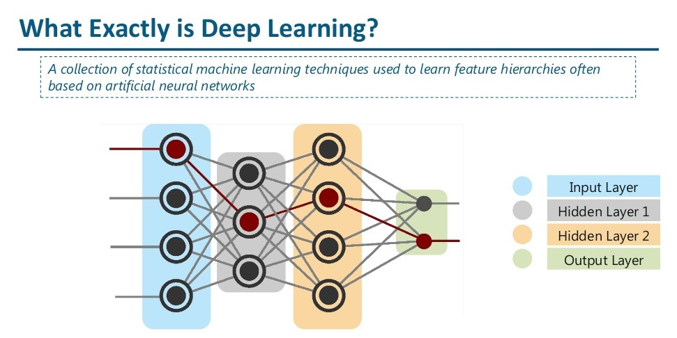
DEEP LEARNING IN ARTIFICIAL INTELLIGENCE

Slide 8
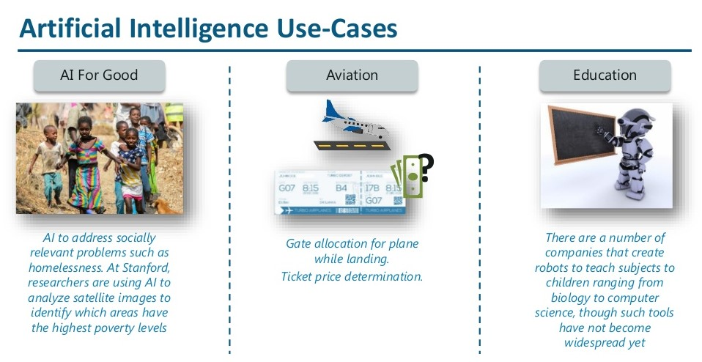

Slide 9
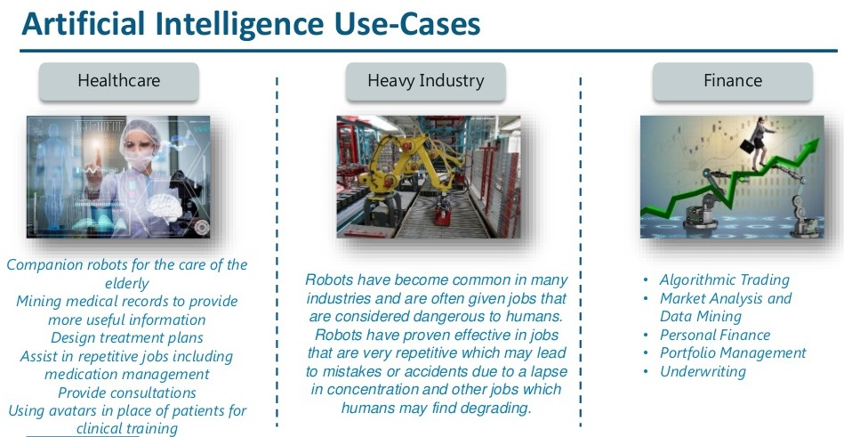

Slide 10
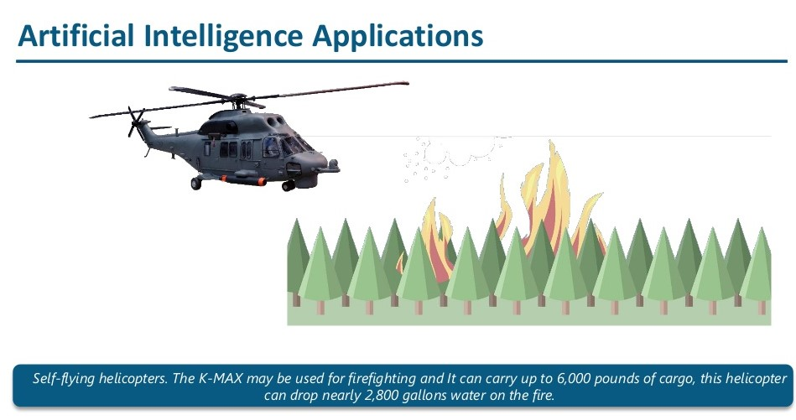

Slide 11
PROS & CONS OF ARTIFICIAL INTELLIGENCE
ACCURACY
COST INCURRED IN THE MAINTAIN & REPAIR
SPACE EXPLORATION
NOT ABLE TO ACT ANY DIFFERENT
USED TO MINING PROCESS
LACK THE HUMAN TOUCH
CAN DO LABORIOUS TASKS
LACK THE CREATIVE MIND
MANAGE RECORDS
UNEMPLOYMENT

Slide 12
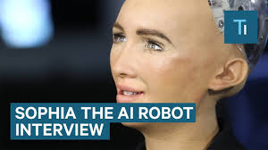
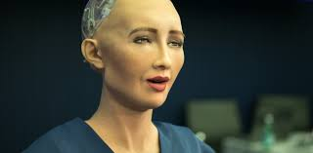
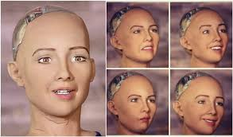
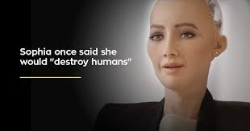

Slide 13
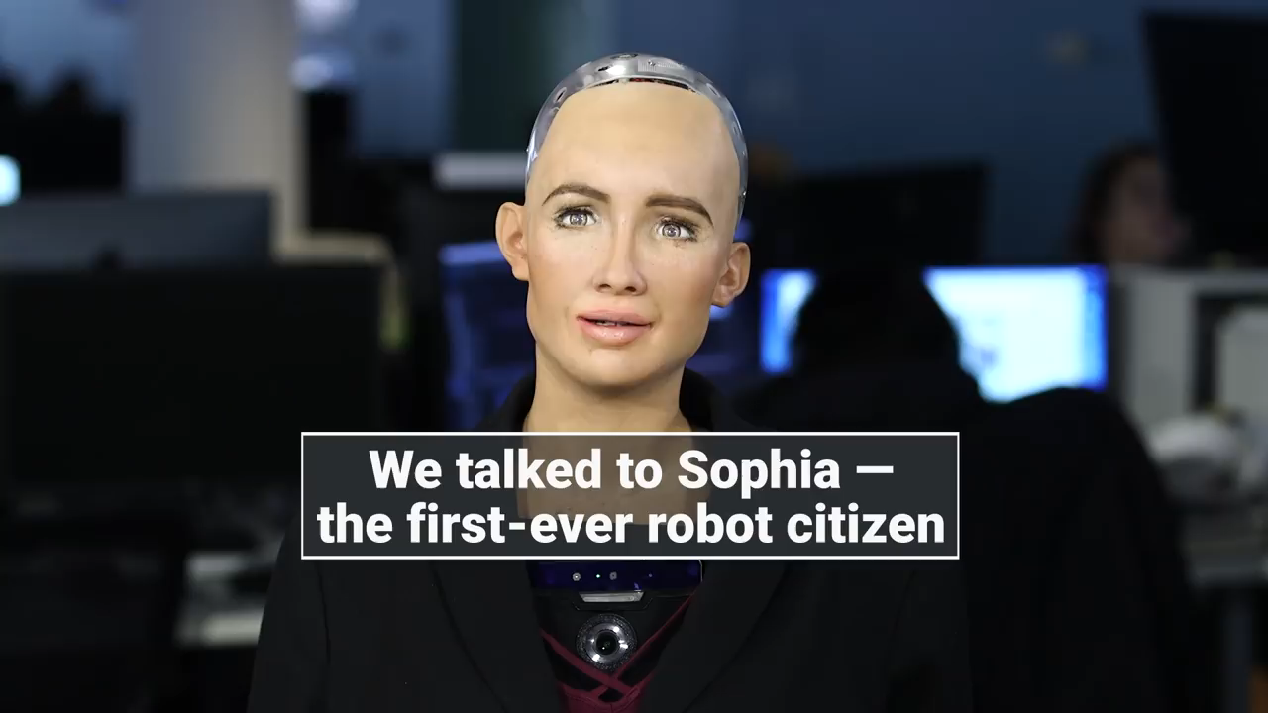

Slide 14


